Slide 1
WELCOME TO WEEK 3 OF SOFTWARE DEVEOPMENT TOOLS PRESENTATION

Slide 2

UNIVERSITY OF BUEA FACULTY OF ENGINEERING AND TECHNOLOGY DEPARTMENT OF COMPUTER ENGINEERING LEVEL 300
SOFTWARE DEVELOPMENT TOOLS CEF 333
GROUP 1 PRESENTATION WEEK THREE
AGILE DEVELOPMENT METHODOLOGIES WITH SCRUM
S/N | GROUP MEMBER | MATRICULATION NUMBER
1. | LENYA SHAMPEL LENYA | FE23A001
2. | ACHUO PLACID ACHUO-ASSAM | FE23A004
3. | AFUH CHIKE CHEWAKONDI | FE23A005
4. | AGBORNJA BESONG AKPAK DIVINE | FE23A006
5. | AKOH JUNIOR NGOH | FE23A008
COURSE FACILITATOR: DR. NKEMENI Valery
COURSE FACILITATOR: DR. NKEMENI Valery

Slide 3
EXPLANATION OF TERMS

Slide 4
Agile Methodology This is an SDLC model that consist of breaking down the entire project into phases which can be worked on, completed, deployed separately before moving on to the next phase
Scrum methodology This is an agile product management framework permitting, in our context, software development teams to create and deliver products faster through iterative progress towards well defined goals
Taiga Open-source management platform which combines the elements of scrum, Kanban and agile methodologies
It is the tool that will contain our scrum board

Slide 5
Diving deeper into scrum

Slide 6
Scrum board: Used to visualize the work flow and progress of the work
Roles
Product owner: Defines the product’s overall goal
In scrum, he creates, prioritizes and maintains the product backlog
Scrum master: Organizes and manages scrum sessions
Development team: Cross functional group which execute the different task assigned to them by the scrum master and product owner

Slide 7
Ceremonies: These are essential events that facilitate collaboration and improvement on the project
Sprint planning: Initiating the sprint and defining goals
Daily scrum review: Reviewing and synchronizing work done so far by the team members
Sprint goal: specific sprint objective

Slide 8
Scrum artifacts
Product backlog: prioritized list of features with their user stories
Sprint backlog: Product backlog items for the current sprint being worked on

Slide 9
PRESENTATION OF SCRUM IMPLEMENTATION VIA TAIGA

Slide 10
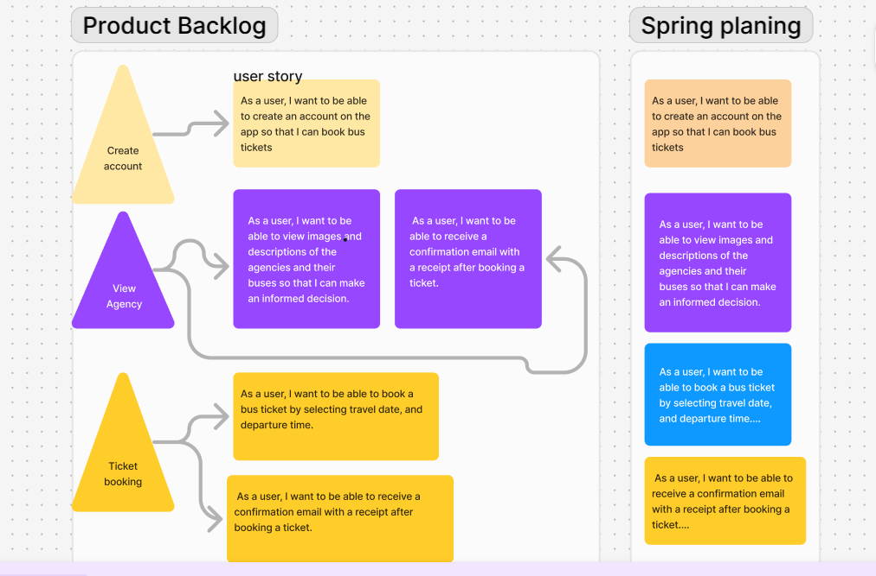
Product backlog and User stories

Slide 11
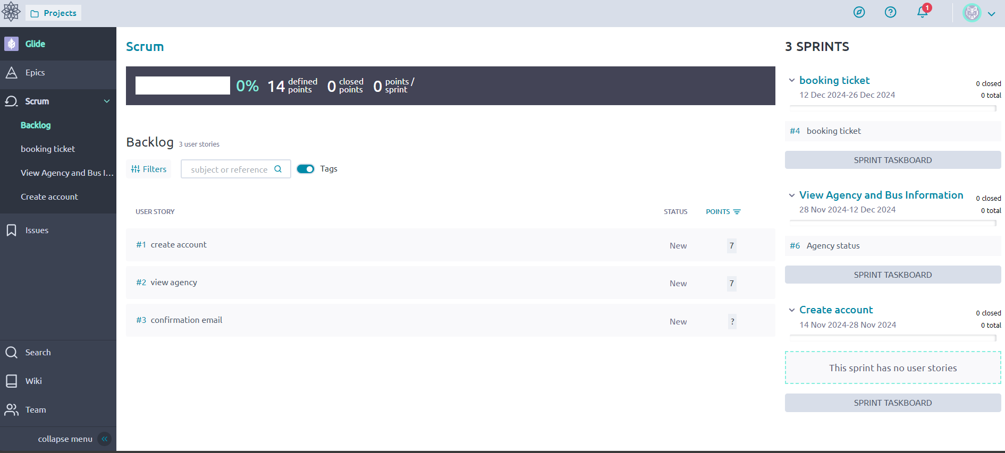
The scrum board

Slide 12
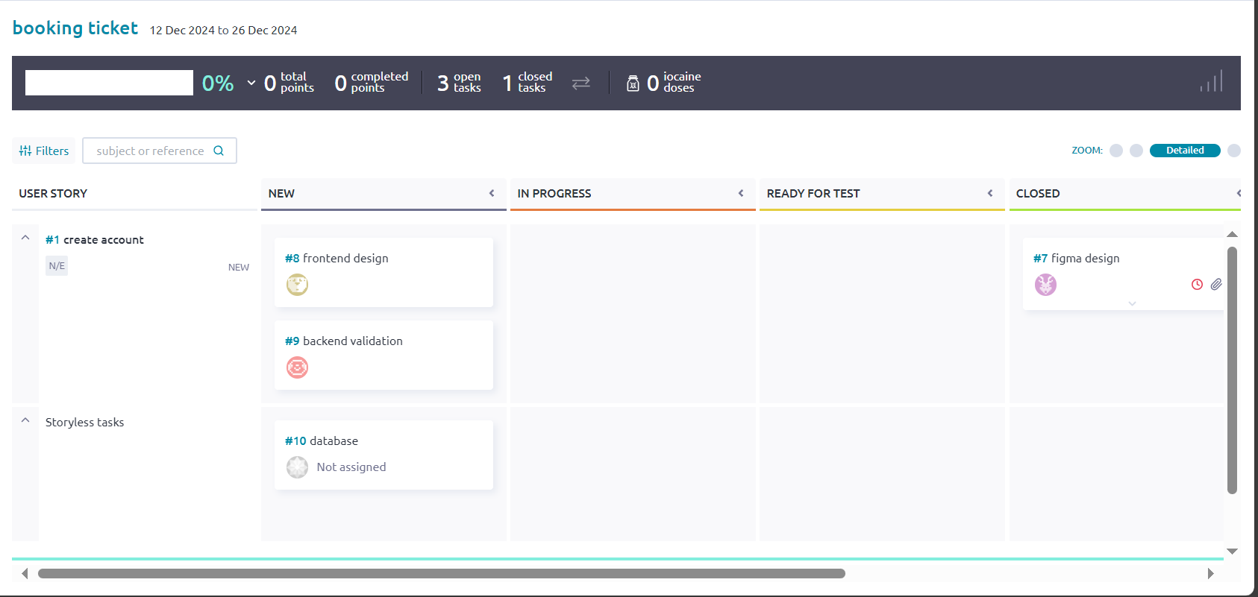
Current sprint and Sprint backlog
Create account

Slide 13
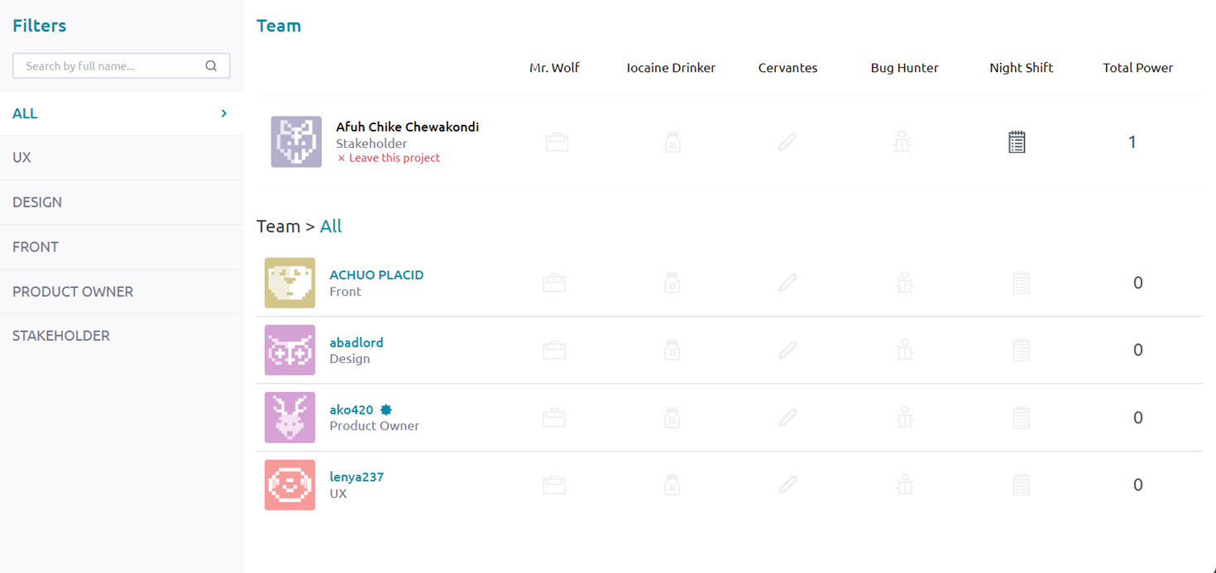
Task assigned and roles

Slide 14
Explanation of user stories and task

Slide 15
User stories
These are descriptions of features of the product from the end user perspective
The format is
As a “user-role”, I want to “goal” so that “benefit”
The user story for this first sprint was :
As a new user, I want to be able to create an account so that I can book bus tickets
For this feature to be generated, a set of task has to be done by team members

Slide 16
Tasks
These are units of work that need to be completed in order to implement a user story
Tasks executed for the mentioned user story are

Slide 17
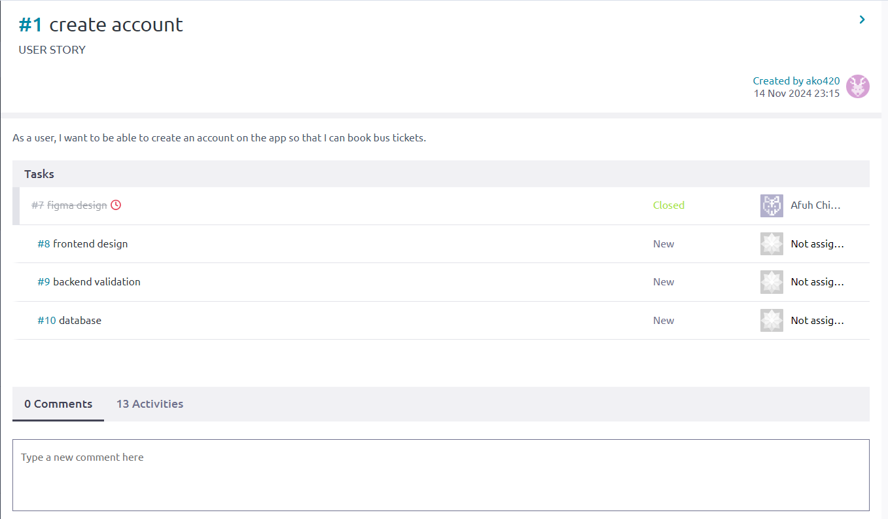
Task

Slide 18
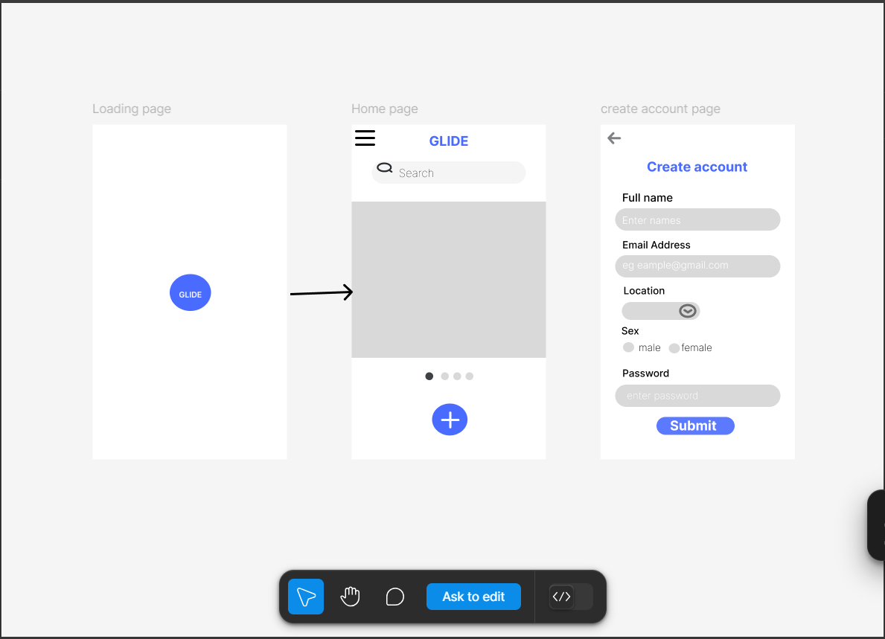
Task that was executed
This is the design of the account creation pages made by our designer, Ako Junior

Slide 19
THE END !!!

